Slide 1
The New Ukraine SIG
One Year Later
Dr. Ronald D. Doctor, Coordinator
JewishGen Ukraine Special Interest Group (SIG)
rddpdx@gmail.com
www.jewishgen.org/ukraine

Slide 2
Mission for the First two years
Revitalize Ukraine SIG
so that it is a useful resource for Jewish family history researchers

Slide 3
Objective
Acquire, translate and make freely available, documents, data and other resources to assist researchers whose Jewish ancestors lived in Ukraine

Slide 4
Ukraine SIG
Geographical Coverage
(Provinces of the former Russian Empire)
Chernigov
Kharkov
Kherson
Kyiv
Podolia
Poltava
Taurida
Volhynia
Yekaterinoslav
Some parts of modern Ukraine are not included

Slide 5
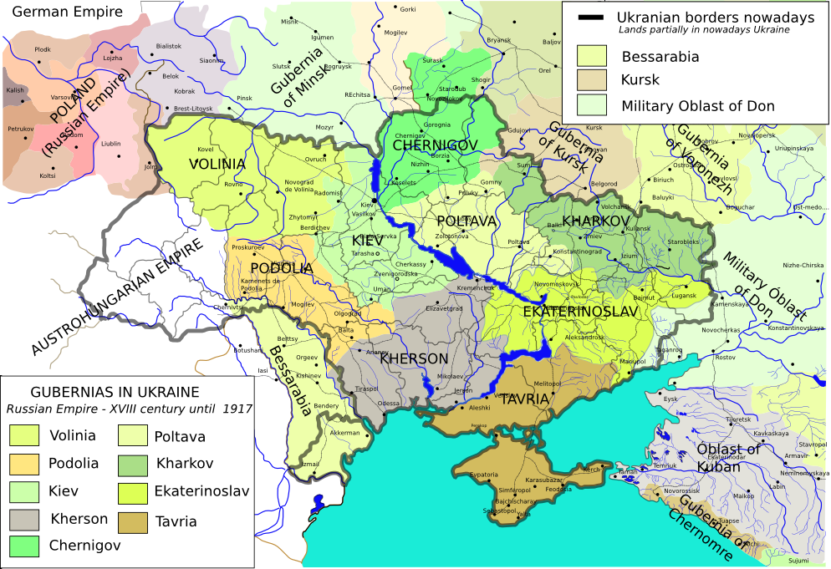

Slide 6
Areas in modern Ukraine
NOT under Ukraine SIG
Bessarabia (new Bessarabia SIG)
Sub-Carpathia (Hungary SIG)
Western Ukraine lands that were in Galicia during Interwar period (Gesher Galicia)
Most of Bukovina (Romania SIG)
(For an explanation of these assignments, see http://www.jewishgen.org/projects/desc/ShtetlMasterRegions.html)

Slide 7
What We’ll Discuss Today
The Past Year: New SIG, New Projects
The New SIG Website http://www.jewishgen.org/ukraine
Looking Ahead
The Ukraine SIG Languages & Skills Survey
(http://www.jewishgen.org/ukraine/ABT_Survey.asp)

Slide 8
Ukraine SIG
Components of the SIG
E-Mail (Coordinator, Board, Project Managers)
Website
http://www.jewishgen.org/Ukraine
Discussion List
more than 2,876 subscribers
Facebook (319 “likes”)
JewishGen Ukraine Database
http://www.jewishgen.org/databases/Ukraine/

Slide 9
Ukraine SIG
Related JewishGen Resources
126 KehilaLinks & other town-based websites; another 35 pending
259 Yizkor Books for 183 towns
Yizkor Book Master Name Index (YBMNI) *
80 towns in Necrology database *
About 60 Cemeteries in JOWBR *
Holocaust database *
FTJP/JGFF *
* = included in JewishGen Ukraine DB

Slide 10
What have we done in the past year?
Structural Changes - 1
Re-structured the Website
  Shifted to Town & District focus
  A Town Page for every town in our database
  Links to datasets and document collections on KehilaLinks websites and elsewhere
Town Leaders …
  Up from none to 151 towns
KehilaLinks Development …
  Up from 47 to 126 KehilaLinks; Another 35 KehilaLinks pending
  10 SIG-Sponsored KehilaLinks
  Assisting 5 KehilaLinks Owners post content on their sites

Slide 11
What have we done in the past year?
Structural Changes - 2
Culture of Mutual Assistance … Improved Communications
  Re-vitalized SIG Discussion Group … 8.6% growth in subscribers
  Created Facebook site … still a work-in-progress
  Ensure responses to messages and requests for help
  Posted 2 PowerPoint Tutorials
  Created 28 InfoSheets & “How-to” documents
  (http://www.jewishgen.org/ukraine/RES_Infosheets.asp)
Online Survey of Languages & Skills
(http://www.jewishgen.org/ukraine/ABT_Survey_Lang_Form.asp)
  Almost 250 volunteers ... up from none
  70 translators currently working … up from none

Slide 12
What have we done in the past year?
Projects - 1
Books with name lists: 3 projects in-progress, 1,000s of names
Prenumeranten: more than 200 books … 10,000s of names.
2 lists (1,800 names) ready for posting; 2 others in-progress.
Name Lists: Trostyanets 1919 Pogrom List & Vishnevets 1748 Residents List ready for posting. 5 others in-progress
Russian language websites: Creating catalog, extracting records with 1,000s of names and short biographical name lists.
Archives Catalog Cards: 1,331 cards for 25 towns, so far from CAHJP, plus 204 for Chechelnik from Vinnitsa State Archive.
Cemeteries: Trostyanets, Yampol, Zhitomir; 5,000 stones.
Censuses: 1795 Ostrog… 3,000 entries; 1811 Uman… 1,000 entries.

Slide 13
What have we done in the past year?
Projects - 2
EIDB Reindexing: Shumsk & Vishnevets done (1,100 manifests), Kamennyy Brod & Verbovets and 19 others are in-progress.
KehilaLinks Data Extraction: Ananyev, Berdyansk, Poninka, 2 Agricultural Colonies almost done.
KehilaLinks Development: 10 SIG-sponsored sites created; Assisting owners with 5 other websites.
Vital Records: Chernigov, Monastyrishche, Odessa … 14,000 names ready for posting; Translation in-progress for Mokraya Kaligorka, Shpola, Ol’shana (3,200 names)
Yad Vashem Extracts: Kamennyy Brod in-progress

Slide 14
What have we done in the past year?
Projects - 3
Yizkor Book Indexing: PowerPoint Tutorial created;
4 books indexed and submitted for posting, 7,500 names
Yizkor Book Translations: Radzivilov (Chervonoarmeysk) in-progress. 4 other books waiting for available Yiddish translators
Presentations to 3 Jewish Genealogical Societies
Many more projects are ready to go … waiting for project managers and volunteers

Slide 15
Looking Ahead
Vital Records, Revision Lists, Holocaust Records
LDS Family History Library Microfilms
  Vital Records for 111 towns
  Revision Lists (19th Century Censuses) for 158 towns
CAHJP - vital records, kahal docs, official documents … 1,331 catalog cards, 25 towns, so far
Obtain & translate Holocaust era documents
  USHMM has 293 documents
  Yad Vashem has more than 1,000 documents

Slide 16
Looking Ahead
Russian Language Websites
Marilyn Robinson’s Research Finds:
  Forum Revival Union Pedigree Traditions
    http://forum.svrt.ru/index.php
  IOP Genealogy Forum
    http://forum.vgd.ru/index.php
  Jewish Roots Forum
    http://www.forum.j-roots.info/index.php
  Jewish Roots Portal
    http://j-roots.info/site/
  Megapolis
    http://www.megapolis.org/
  Poiskpeople.ru
Records and Lists of all types!

Slide 17
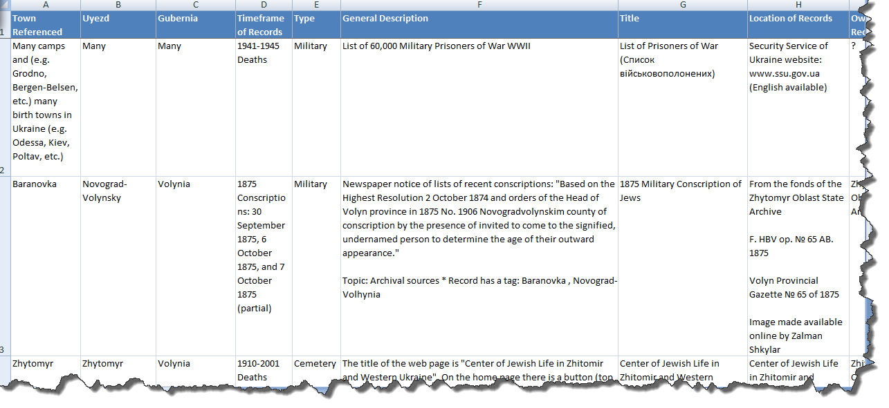
Russian Language Websites
Creating a Catalog

Slide 18
Russian Language Websites
Center for Genealogical Research http://www.rosgenea.ru
Biographical Name Lists
Кац Арон Наумович (1899,Смоленск---1936) еврей, арестован в 1936 г., осудивший орган: Тройка УНКВД по ДС, осужден 1937.09.10, статья: контрреволюционная троцкистская деятельность, расстрелян 1937.10.01, реабилитирован 1989.03.18 [Магадан]
Google Translation
Aaron Katz Naumovich (1899, Smolensk --- 1936), a Jew, was arrested in 1936, which condemned the organ: NKVD Troika of DC, convicted 1937.09.10, Article: Trotskyist counter-revolutionary activities, was shot 1937.10.01, 1989.03.18 rehabilitated [Magadan ]

Slide 19
Our Success Depends on You
Will you volunteer?
  No special skills needed for several projects
  Limited language skills needed for some projects
  Some require data input to spreadsheets
Series of Surveys … Languages Survey at:
  http://www.jewishgen.org/ukraine/ABT_Survey_Lang_Form.asp
No skills or time? Help by donating $
http://www.jewishgen.org/JewishGen-erosity/v_projectslist.asp?project_cat=22

Slide 20
Continue? … 4 Choices
Discuss Project Details
Tour of the Website
On-line Survey Results
Enough … Let’s Stop

Slide 21
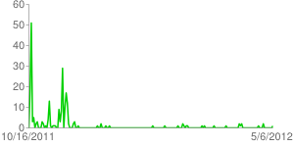
Ukraine SIG Online Survey
Number of Daily Responses
Announcement of Availability
Reminder
Added IAJGS Print Surveys

Slide 22
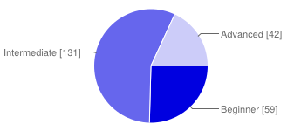
Ukraine SIG Online Survey
Genealogical Research Level
Beginner | 59 | 25%
Intermediate | 131 | 56%
Advanced | 42 | 18%

Slide 23
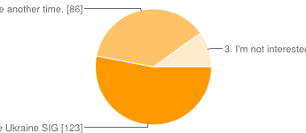
Ukraine SIG Online Survey
Willingness to Volunteer
1. I am willing to volunteer to help revitalize the Ukraine SIG | 123 | 53%
2. Sorry, I can't volunteer right now. Check with me another time. | 86 | 37%
3. I'm not interested in volunteering | 23 | 10%

Slide 24
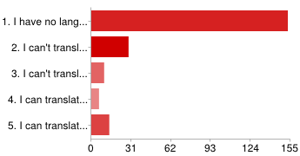
Ukraine SIG Online Survey
Language Skills, Russian (Cyrillic)
1. I have no language skills that would be helpful | 153 | 66%
2. I can't translate but I can transliterate printed text | 29 | 13%
3. I can't translate but I can transliterate handwritten & printed text | 10 | 4%
4. I can translate printed text | 6 | 3%
5. I can translate handwritten and printed text | 14 | 6%

Slide 25
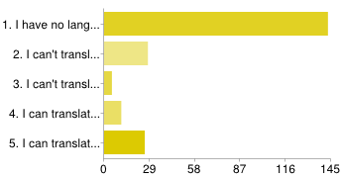
Ukraine SIG Online Survey
Language Skills, Hebrew
1. I have no language skills that would be helpful | 143 | 62%
2. I can't translate but I can transliterate printed text | 28 | 12%
3. I can't translate but I can transliterate handwritten & printed text | 5 | 2%
4. I can translate printed text | 11 | 5%
5. I can translate handwritten and printed text | 26 | 11%

Slide 26
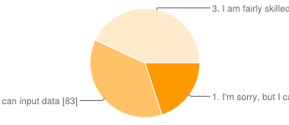
Ukraine SIG Online Survey
Spreadsheet Skills
1. I'm sorry, but I can't help with spreadsheets | 45 | 19%
2. I'm not particularly skilled, but I can input data | 83 | 36%
3. I am fairly skilled in using Excel spreadsheets | 97 | 42%

Slide 27
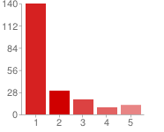
Ukraine SIG Online Survey
Web & HTML Skills
1. I have no website or HTML skills | 140 | 60%
2. | 30 | 13%
3. | 19 | 8%
4. | 9 | 4%
5. I am fairly skilled in working with web pages and HTML | 12 | 5%

Slide 28
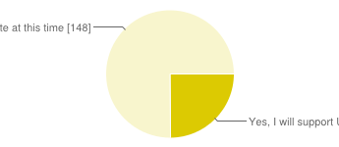
Ukraine SIG Online Survey
Donations http://www.jewishgen.org/JewishGen-erosity/
Yes, I will support Ukraine SIG's work with a donation | 49 | 21%
No, I can't donate at this time | 148 | 64%

